Slide 1



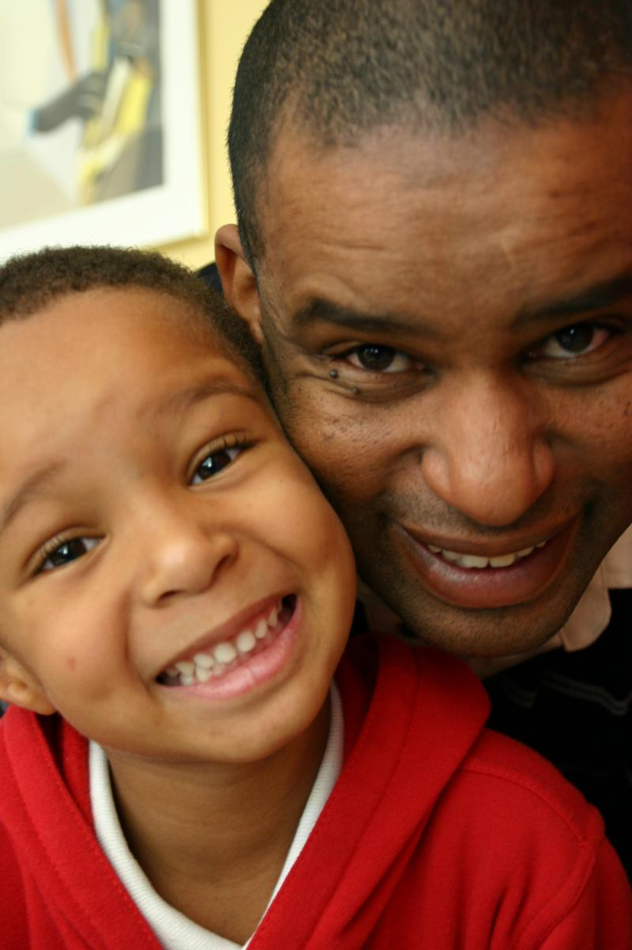
Giving New Voice An SCDAA Overview…..
“Break The Sickle Cycle”
By: Beverley Francis-Gibson
President & CEO
Sickle Cell Disease Association of America, Inc.

Slide 2
The Sickle Cell Disease Association of America, Inc. (SCDAA) serves as the nation’s only volunteer organization working full time on a national level to resolve issues surrounding sickle cell disease.

Slide 3

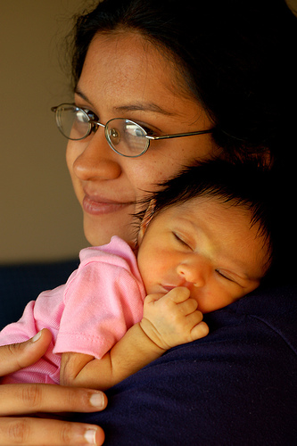
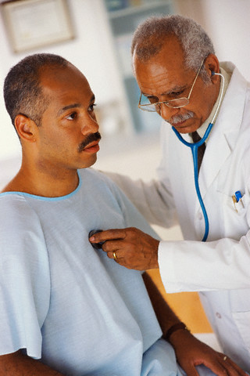

Our Mission
"To advocate for people affected by sickle cell conditions and empower community-based organizations to maximize quality of life and raise public consciousness while advancing the search for a universal cure."

Slide 4

Our Members
“MO’s are the foundation to both SCDAA and the SCD community.”
Forty-five (45) community-based organizations designed to serve individuals and families in their respective communities by offering program and outreach services.
Assist clients with finding quality healthcare
Maintain databases of individuals and families that have been served over the years
Community Outreach
Educate local communities

Slide 5
SCDAA Members are classified in the following categories:
DIRECT PATIENT CARE SERVICES
SUPPORT SERVICES
ADVOCACY SERVICES

Slide 6

Giving New Voice
SCDAA Current Initiatives

Slide 7
2018 – 2019 Key Focus Areas
AWARENESS & OUTREACH
LEGISLATIVE ADVOCACY
CBO CAPACITY BUILDING
KEY PARTNERSHIPS AND COLLABORATIONS
TREATMENT & RESEARCH

Slide 8
Community – Based Capacity Building
SCDAA Leadership & Training Academy
Professional Training
Organizational Capacity Training
Program Training
National SCD Community Health Worker (CHW) training program
National Sickle Cell Advocacy Network (NSCAN)
Notes:
NSCAN: a national network of patients and families who advocate, educate and help people living with or who are affected by SCD: the network includes caregivers, clinicians, stakeholders and experts

Slide 9
Legislative Advocacy
Introduced the Re-Authorization of Sickle Cell Treatment Act Companion Bill to Bill H.R. 2410 in the House
Treatment Centers, Surveillance, Clinical Research and Transition programs
Partnership with ASH, MAP and others organizations to support legislation in support of individuals and families living and coping with sickle cell disease.

Slide 10
Awareness & Outreach
Clinical Trial Awareness Initiatives
Bone Marrow Donation and Donor Education
National Blood Drive Campaign
Hydroxyurea Education
National Public Awareness Campaigns

Slide 11
Research & Programs
HRSA Newborn Screening Coordinating Center
Establish a national infrastructure to ensure diagnosed individuals receive follow-up services: counseling, education materials and access to a medical home
Get Connected Patient Powered Registry-to date 6,190 individuals are registered

Slide 12
Purpose of “Get Connected”….
Establish a network of children, adults and families living with sickle cell disease, SCDAA member organizations, health care providers and other community-based organizations to distribute information related to clinical care, research, health services, health policy and health care advocacy
Establish a registry for children and adults living with sickle cell disease to store medical information related to diagnosis, treatment and potential cure
Establish a network of providers that are educated about the unique health care and psychosocial needs of children and adults living with sickle cell disease
Connect children and adults with sickle cell disease to high quality resources for information on health care including behavioral health, clinical research and ancillary health care resources
Establish a network to support clinical research through community-based research navigators

Slide 13
Blood Disorders – Basic and Translational Research
Moderator: Beverley Francis-Gibson, Sickle Cell Disease Association of America
Speakers Merlin Crossley, University of South Wales
Sivaprakash Ramalingam, Institute of Genomics and Integrative Biology Matthew Porteus, Stanford University Junjiu Huang, Sun Yat-sen University Vence L. Bonhan, National Human Genome Institute

